Slide 1
Customer Churn analysis project

Slide 2
Objective
Identify customers who have churned and analyze patterns to identify the best customers to target

Slide 3
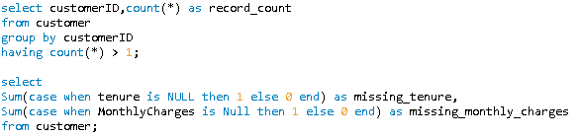
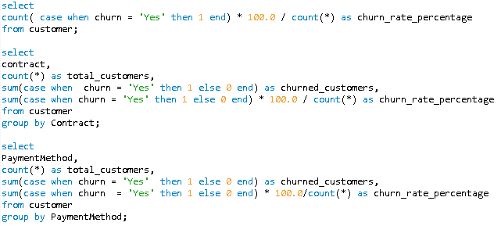
Data preparation and EDA using SQL

Slide 4
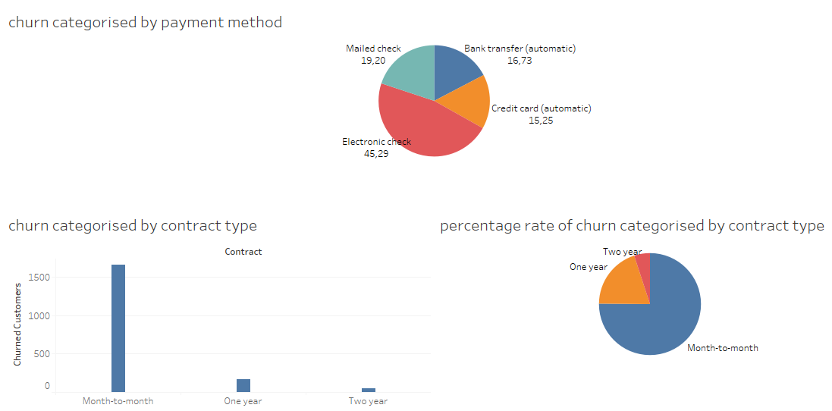
Key Insights

Slide 5
Key Insights
Electronic check has the highest customer churn rate
Credit cards have the lowest customer churn rate
Month to month contracts have the highest customer churn rate
Two year contracts have the lowest customer churn rate

Slide 6
Conclusion
The company must focus on marketing and selling more Two year contracts and indicate the credit card payment method as the main payment method

Slide 7
Sources
Telco customer database
https://drive.google.com/file/d/1YFL0YWFhaQVtVUe-t0ihxg9vZvywqDE3/view?usp=drive_link
Customer churn sql file
https://drive.google.com/file/d/1ylnfqulBdeb7rXC8fgWKG-6KmvCpWEKu/view?usp=drive_link
Customer churn dashboard
https://drive.google.com/file/d/1JLfnBvq4qPSeCPfpSt-geIUG9jrQ9hbV/view?usp=drive_link

